Slide 1

Computerized Violation Processing & Records Management System
PHILIPPINE NATIONAL POLICE | LA UNION POLICE PROVINCIAL OFFICE
LIVE CHECKPOINT SCREENING
Instant plate, license & warrant check
Plate ABC-1234
ALARM
HPG alarm / stolen vehicle match
PNP-CVPRMS
Real-time checkpoint screening, statutory fine calculation, thermal citation POS, and centralized treasury synchronization | Release v2.0-PRO
Test: expired reg.
WARNING
Expired registration or suspended license
COURSE Software Engineering 2 - Final Capstone Defense
STATION Agoo Municipal Police Station, Region 1
STACK Multi-tier REST app: Node.js/Express, SQLite3, semantic UI, POS engine
REPO https://github.com/Credoz/PNP-CVPRMS
Test: valid driver
CLEAR
Valid driver, no flags on any watchlist
PROJECT TEAM (8 MEMBERS)
Sub-second screening with color-coded badges
Casey Freud (Team Leader) | Angelo | Antonio | Augusto Manuel | Benjie | Emmanuel John | Genuflect | Ranier
Notes:
SPEAKER: Casey Freud (Team Leader)
ALLOTTED TIME: 1.0 Minute
RUBRIC ALIGNMENT: Overview & Presentation Framing
TALKING POINTS:
- Good day to our respected panel and professors. Today our team proudly presents the Computerized Violation Processing and Records Management System, or PNP-CVPRMS.
- Built specifically for the Philippine National Police, with Agoo Municipal Police Station as our pilot deployment, this system modernizes roadside checkpoint operations.
- It tackles long-standing law enforcement bottlenecks: transforming slow, error-prone manual paper tickets into an instantaneous, computerized platform featuring real-time intelligence screening, statutory fine calculation, thermal POS printing, and centralized treasury synchronization.
- All 8 team members are present, and every member will present a dedicated technical component and answer panel questions.

Slide 2
Presentation Roadmap & Team
DELIVERY & TIME MANAGEMENT | RUBRIC CATEGORY C
Casey Freud | 1.0 min
MEMBER | PRESENTS | MIN | BUILD ROLE & SCM OWNERSHIP
Casey Freud (Lead) | Opening, problem statement, objectives, demo co-host, analytics | 3.5 | Backend architecture & pseudocode server.js, README.md
Angelo | Scope: target cloud vs. prototype, requirements traceability | 3.0 | REST API endpoints & structure chart server.js, User Manual
Augusto Manuel | Context DFD (Stage 0), system boundaries & data flows | 3.0 | Frontend UI/UX, SCM plan & ERD index.html, SCM_PLAN.md
Emmanuel John | Level 1 DFD (8 subsystems), technical challenges | 3.0 | Database administration & assets pnp_checkpoint.db, DFD 1
Antonio | Relational data model (ERD), architectural trade-offs | 3.0 | SQLite schema, migrations & data dictionary server.js, Schema SQL
Ranier | HIPO VTOC, structure chart, SCM governance & CIs | 3.0 | Git policies, ignore rules & HIPO .gitignore, HIPO diagrams
Benjie | Tech stack rationale, core algorithms & validation | 3.0 | Dependencies & DFD process flows package.json, DFD Stage 0
Genuflect | 14-test QA suite, quality report, defect remediation | 3.0 | Automated QA suite & builds features.test.js, DFD 2
All members | Panel defense Q&A session | 10.0 | Every member answers at least one question
20 min
presentation + live demo
10 min
panel defense & Q&A
100-POINT RUBRIC
60
Category A
Technical content, criteria 1-6
15
Category B
Live demonstration
25
Category C
Delivery, visuals & Q&A
Notes:
SPEAKER: Casey Freud
ALLOTTED TIME: 1.0 Minute
RUBRIC ALIGNMENT: Category C - Organization & Time Management (5/5 pts)
TALKING POINTS:
- As mandated by the Software Engineering 2 rubric, our session is strictly budgeted for a 20-minute presentation and live demo, followed by 10 minutes of panel defense.
- To demonstrate complete team synergy and accountability, our 8 team members have divided the technical content according to our Software Configuration Management ownership.
- Every single member will present their assigned domain and take questions during our 10-minute defense period.

Slide 3




Problem Statement: Checkpoint Realities
CATEGORY A | CRITERION 1: PROBLEM & OBJECTIVES (10 PTS)
Casey Freud | 1.5 min
Manual paper ticketing bottleneck
Zero real-time intelligence screening
Hand-written TVR/OVR takes 8-12 minutes per motorist stop
Illegible entries cause wrong plates, misspelled names, contested citations
Paper slips get lost, damaged, or altered with no audit trail
No instant check of plates against HPG alarms
Stolen vehicles pass when hotlist checks are impossible at peak traffic
Court warrants and wanted persons can't be cross-referenced at roadside
Inability to track repeat offenders
Treasury remittance & audit latency
Records at Post A are invisible to Posts B and C
Habitual violators and suspended licenses escape escalated penalties
Unlicensed drivers exploit gaps with unverified fictitious names
Reconciling police slips with the Municipal Treasury takes days or weeks
Unsettled tickets go untracked: lost revenue, no aging reports
Commanders lack real-time views of violation corridors and shift metrics
Notes:
SPEAKER: Casey Freud
ALLOTTED TIME: 1.5 Minutes
RUBRIC ALIGNMENT: Criterion 1 - Problem and Objectives (Target: 9-10/10 Excellent)
TALKING POINTS:
- Roadside PNP checkpoints along major corridors like MacArthur Highway in Agoo handle hundreds of vehicles per shift.
- The current manual paper-based ticketing system suffers from four critical failures:
1. Administrative delays: Taking 8-12 minutes per motorist creates severe traffic congestion.
2. Complete lack of real-time intelligence: Officers cannot verify if an apprehended motorcycle is on the HPG stolen vehicle watchlist or if the driver has an active court warrant.
3. No repeat offender tracking across different checkpoint posts.
4. Disconnect with the Municipal Treasury: Paper records take weeks to reconcile, resulting in uncollected fines and zero data analytics.

Slide 4




Target Users & Stakeholders
CATEGORY A | CRITERION 1: PROBLEM & OBJECTIVES (10 PTS)
Casey Freud | 1.5 min
PRIMARY USERS
EXECUTIVE USERS
REVENUE USERS
PUBLIC STAKEHOLDERS
Checkpoint officers
Station commander
Municipal Treasury
Motorists
Patrolmen & shift leads on duty at Agoo MPS posts
Chief of Police, Traffic Division Chief, records custodians
Cashiers & revenue assessment officers
Apprehended drivers, public utility drivers & commercial operators
CORE NEEDS
CORE NEEDS
CORE NEEDS
CORE NEEDS
Rapid motorist check (<60 s)
Clear / Warning / Alarm screening badges
Auto-calculated statutory fines
Thermal receipt & photo evidence
Real-time dashboard: arrests, fines, alerts
Shift and post density analysis
Tamper-proof append-only audit trail
Filterable violation registry
Instant balance check by ticket or plate
Unsettled to Paid status updates
Official Receipt (OR) recording
Excel-ready UTF-8 BOM CSV export
Stop delay under 1 minute (vs. ~10)
Legible, itemized thermal printout
Transparent fines (LTO JAO 2014-01)
Clear pay-or-contest instructions
Notes:
SPEAKER: Casey Freud
ALLOTTED TIME: 1.5 Minutes
RUBRIC ALIGNMENT: Criterion 1 - Target Users (Target: 9-10/10 Excellent)
TALKING POINTS:
- We designed PNP-CVPRMS around four distinct stakeholder classes in the municipal ecosystem.
- Checkpoint Officers need speed and simplicity under daylight conditions.
- Station Commanders need macro-level intelligence and accountability.
- Municipal Treasury Cashiers need real-time payment reconciliation without paper slip delays.
- And the Public deserves transparent, tamper-proof, itemized citations that clearly state the law violated and legal settlement avenues.

Slide 5
Objectives & Measurable Success Metrics
CATEGORY A | CRITERION 1: PROBLEM & OBJECTIVES (10 PTS)
Angelo | 1.5 min
TARGET
RESULT
90%
Faster issuance
Cut roadside processing from 8-12 minutes to under 60 seconds
Single-screen auto-fill and instant totaling: issuance plus thermal receipt in under 45 seconds
<500 ms
Sub-second screening
Real-time cross-check against watchlists in under 500 ms
Sub-millisecond checks of plates, licenses and warrants with Clear / Warning / Alarm badges
0
Fine discrepancies
100% adherence to LTO JAO 2014-01 penalty schedules
Central offense schedule totals multiple violations; manual overrides are logged
100%
Offline-resilient
Full uptime at checkpoints with intermittent cellular coverage
Embedded SQLite edge design: zero data loss and local reads/writes during blackouts
100%
Audit & reconciliation
Zero-gap traceability between citations and treasury receipts
Live PATCH /api/violations/:id/status, 1-click UTF-8 BOM CSV, 14-test suite (all passing)
Notes:
SPEAKER: Angelo
ALLOTTED TIME: 1.5 Minutes
RUBRIC ALIGNMENT: Criterion 1 - Measurable Objectives (Target: 9-10/10 Excellent)
TALKING POINTS:
- Rather than vague goals, PNP-CVPRMS was engineered against five concrete, measurable engineering benchmarks.
- First: Time efficiency - reducing roadside traffic obstruction by 90%, from 8-12 minutes down to under 60 seconds.
- Second: Sub-second screening against stolen vehicle alarms and warrants.
- Third: Eliminating calculation disputes through standardized statutory offense scheduling.
- Fourth: 100% offline edge resilience using embedded SQLite.
- Fifth: Complete auditability and financial reconciliation with the Municipal Treasury through live PATCH endpoints and Excel-ready UTF-8 CSV exports.

Slide 6
System Scope: Vision vs. Prototype
CATEGORY A | CRITERION 2: REQUIREMENTS & SCOPE (10 PTS)
Angelo | 1.5 min
TARGET PRODUCTION ARCHITECTURE
DEMONSTRATION PROTOTYPE v2.0-PRO (CURRENT)
The vision: multi-station cloud
What we built: a self-contained edge app
Cloud network: one API linking stations, regional HQs and mobile patrols
PostgreSQL cluster: high availability, pooling, read replicas, SSL replication
WebSockets / SSE: live push of new stolen-vehicle and warrant flags
Government gateways: LTO LTMS, HPG Command, Landbank Link.BizPortal / GCash
Mobile patrol PWA: offline-first on rugged Android tablets
Edge web server: Node.js + Express REST API at the checkpoint station
Embedded SQLite3: zero-config, portable pnp_checkpoint.db
Simulated screening: deterministic blacklist rules for plates, licenses, names
Thermal POS printing: 58 mm & 80 mm slips with A4 centering
One-command launch: Start-CVPRMS.bat with preflight check and shortcut installer
Defense justification: zero downtime, zero network dependency, and 100% deterministic test execution for panel evaluation.
Notes:
SPEAKER: Angelo
ALLOTTED TIME: 1.5 Minutes
RUBRIC ALIGNMENT: Criterion 2 - Scope and Boundaries (Target: 9-10/10 Excellent)
TALKING POINTS:
- To earn full marks under Criterion 2, we clearly delineate our target enterprise production architecture from our current v2.0-PRO demonstration release.
- In full deployment, PNP-CVPRMS will interconnect regional police command centers, LTO LTMS registries, and municipal payment portals via cloud WebSockets and PostgreSQL.
- For our capstone defense, we deliberately engineered a self-contained edge prototype. It contains our complete Node.js REST server, embedded SQLite database, and thermal POS engine.
- This architectural design ensures zero-downtime, zero-network-latency presentations regardless of classroom Wi-Fi or police VPN limitations.

Slide 7
Requirements Traceability Matrix
CATEGORY A | CRITERION 2: REQUIREMENTS & SCOPE (10 PTS)
Augusto Manuel | 1.5 min
REQ ID | REQUIREMENT | PRIORITY | IMPLEMENTED MODULE | QA TEST VERIFICATION
FR-01 | Real-time multi-tier screening (plate / driver / license vs. HPG alarms) | CRITICAL | assessScreening() in server.js + client engine | assessScreening flags ALARM & WARNING
FR-02 | Unlicensed driver Alt-ID workflow (PhilID / SSS / Passport mandatory) | HIGH | validateViolationPayload() + form morphing | validateViolationPayload requires Alt-ID
FR-03 | Statutory fine totaling with discretionary override | CRITICAL | calculateViolationTotal() + OFFENSE_SCHEDULE | calculateViolationTotal adds multiple fees
FR-04 | Mandatory impound receipt slip for impounded vehicles | HIGH | validateViolationPayload() + disposition rules | Requires impound receipt when Impounded
FR-05 | Settlement status management & Excel CSV export (UTF-8) | HIGH | PATCH /api/violations/:id/status + CSV generator | PATCH updates settlement & rejects invalid
Every critical requirement maps to a backend function, a UI element, and a dedicated automated regression test.
Notes:
SPEAKER: Augusto Manuel
ALLOTTED TIME: 1.5 Minutes
RUBRIC ALIGNMENT: Criterion 2 - Requirements and Scope (Target: 9-10/10 Excellent)
TALKING POINTS:
- In software engineering, every feature must be traceable back to an approved requirement and verified by an automated test.
- Here we present our Requirements Traceability Matrix. Notice how every critical functional requirement - from FR-01 screening to FR-05 payment settlement - maps directly to:
1. Specific backend functions in server.js,
2. Concrete UI elements in index.html, and
3. Dedicated automated regression tests in our test suite.
- For example, FR-02 handles unlicensed drivers by enforcing alternative government IDs, and our test runner explicitly verifies both failure on missing IDs and success on valid National IDs.

Slide 8
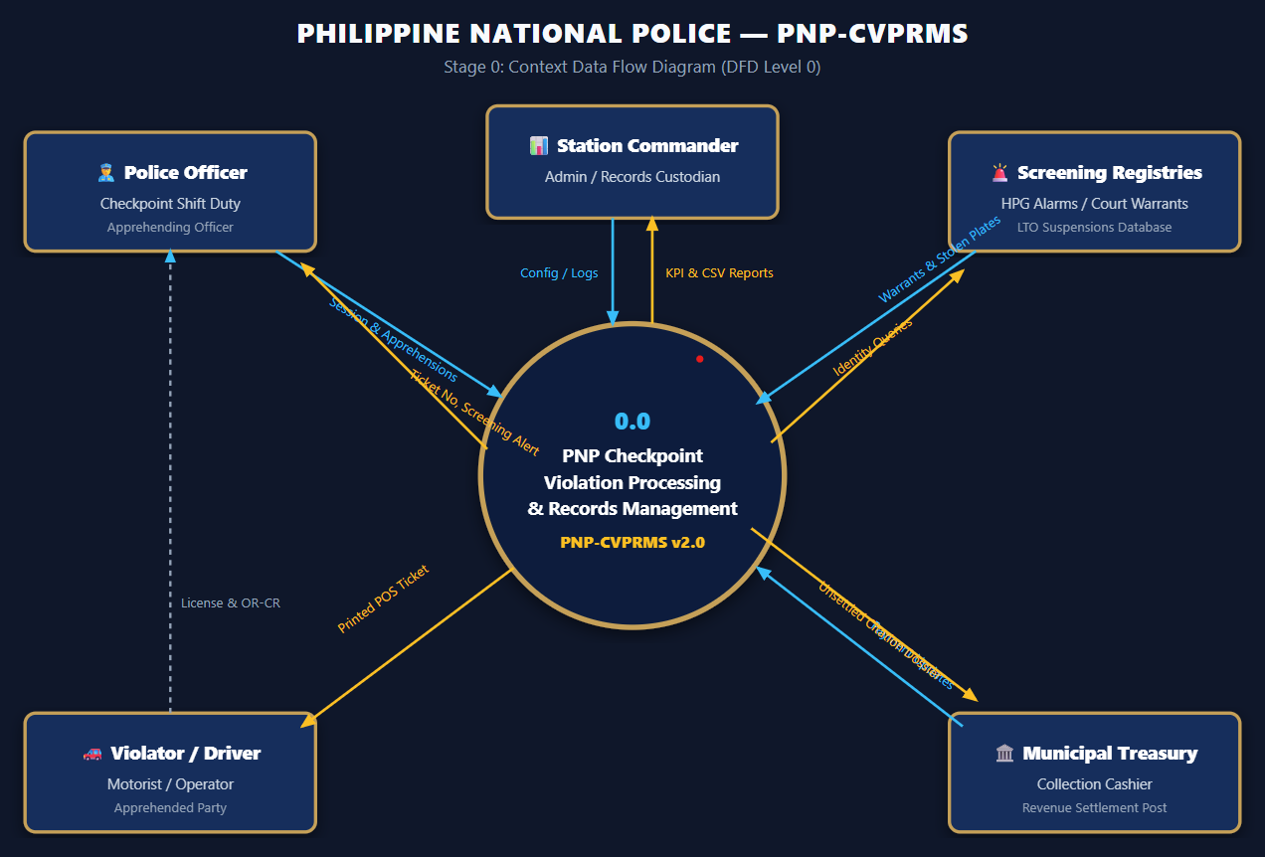
Context Diagram (Stage 0 DFD)
CATEGORY A | CRITERION 3: SYSTEM DESIGN & ARCHITECTURE (15 PTS)
Augusto Manuel | 1.5 min
5 EXTERNAL ENTITIES
Apprehending Police Officer
In: session, violator data, evidence photos
Out: screening badge, fines, ticket ID
Apprehended Motorist
In: license / Alt-ID, OR-CR documents
Out: printed thermal citation receipt
Municipal Treasury
In: Official Receipt (OR) confirmation
Out: outstanding balances & unsettled files
Law Enforcement Registries
In: plate / license / driver queries
Out: HPG stolen-vehicle alarms, court warrants
Station Commander
Out: KPI summaries, audit trails, CSV exports
CENTRAL PROCESS 0.0
PNP Checkpoint Violation Processing & Records Management System
Notes:
SPEAKER: Augusto Manuel
ALLOTTED TIME: 1.5 Minutes
RUBRIC ALIGNMENT: Criterion 3 - System Design and Architecture (Target: 14-15/15 Excellent)
TALKING POINTS:
- On this slide, we present the Context Diagram, or Stage 0 DFD, representing the high-level boundary of our system.
- The central process - 0.0 PNP-CVPRMS - interfaces directly with five external entities.
- Notice the bidirectional flows: The Apprehending Officer feeds checkpoint session details and evidence photos, receiving immediate screening badges and auto-calculated statutory fines.
- The Motorist receives an official thermal citation slip.
- The Municipal Treasury exchanges settlement updates.
- External registries supply stolen vehicle alarms and court warrants.
- And the Station Commander extracts high-level KPI summaries and audit trails.

Slide 9
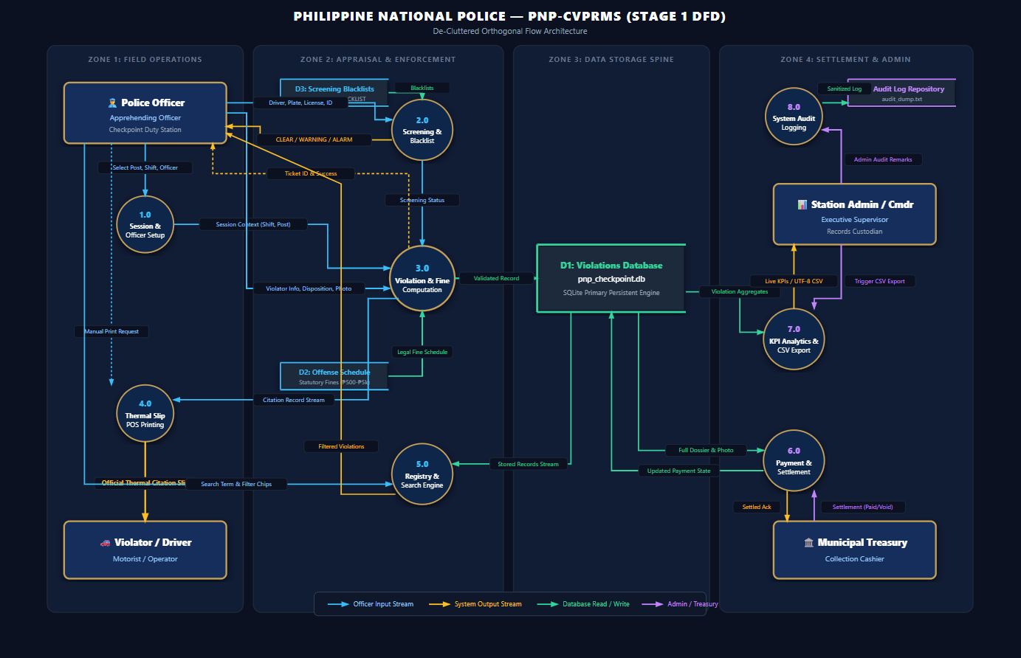
Process Decomposition: Level 1 DFD
CATEGORY A | CRITERION 3: SYSTEM DESIGN & ARCHITECTURE (15 PTS)
Emmanuel John | 1.5 min
8 FUNCTIONAL SUBSYSTEMS
1.0 Session Setup
station, post, shift, badge binding
2.0 Screening Engine
HPG alarm & warrant cross-match
3.0 Apprehension & Fine
validation, totaling, photo compression
4.0 Thermal POS Print
58/80 mm slips with settlement notes
5.0 Registry & Search
plate, ticket, driver, shift, date
6.0 Dossier & Settlement
Unsettled to Paid / Voided
7.0 KPI & CSV Export
live metrics, UTF-8 BOM CSV
8.0 Secure Audit Logger
append-only legal accountability log
DATA STORES
D1 Violations DB | D2 Offense Schedule | D3 Blacklists | D4 Audit Log
Notes:
SPEAKER: Emmanuel John
ALLOTTED TIME: 1.5 Minutes
RUBRIC ALIGNMENT: Criterion 3 - Process Decomposition (Target: 14-15/15 Excellent)
TALKING POINTS:
- Decomposing the system one level deeper, our Level 1 DFD illustrates how data is transformed across eight core subsystems and four distinct data stores.
- Process 1.0 sets the operational session context.
- Process 2.0 performs sub-millisecond screening against Data Store D3.
- Process 3.0 computes statutory fines from Data Store D2 and commits valid records to Data Store D1.
- Process 4.0 formats and triggers thermal POS printouts.
- Processes 5.0 through 7.0 govern search, payment status updates with the Treasury, and analytical exports.
- Process 8.0 records every administrative transaction into an append-only audit repository.

Slide 10
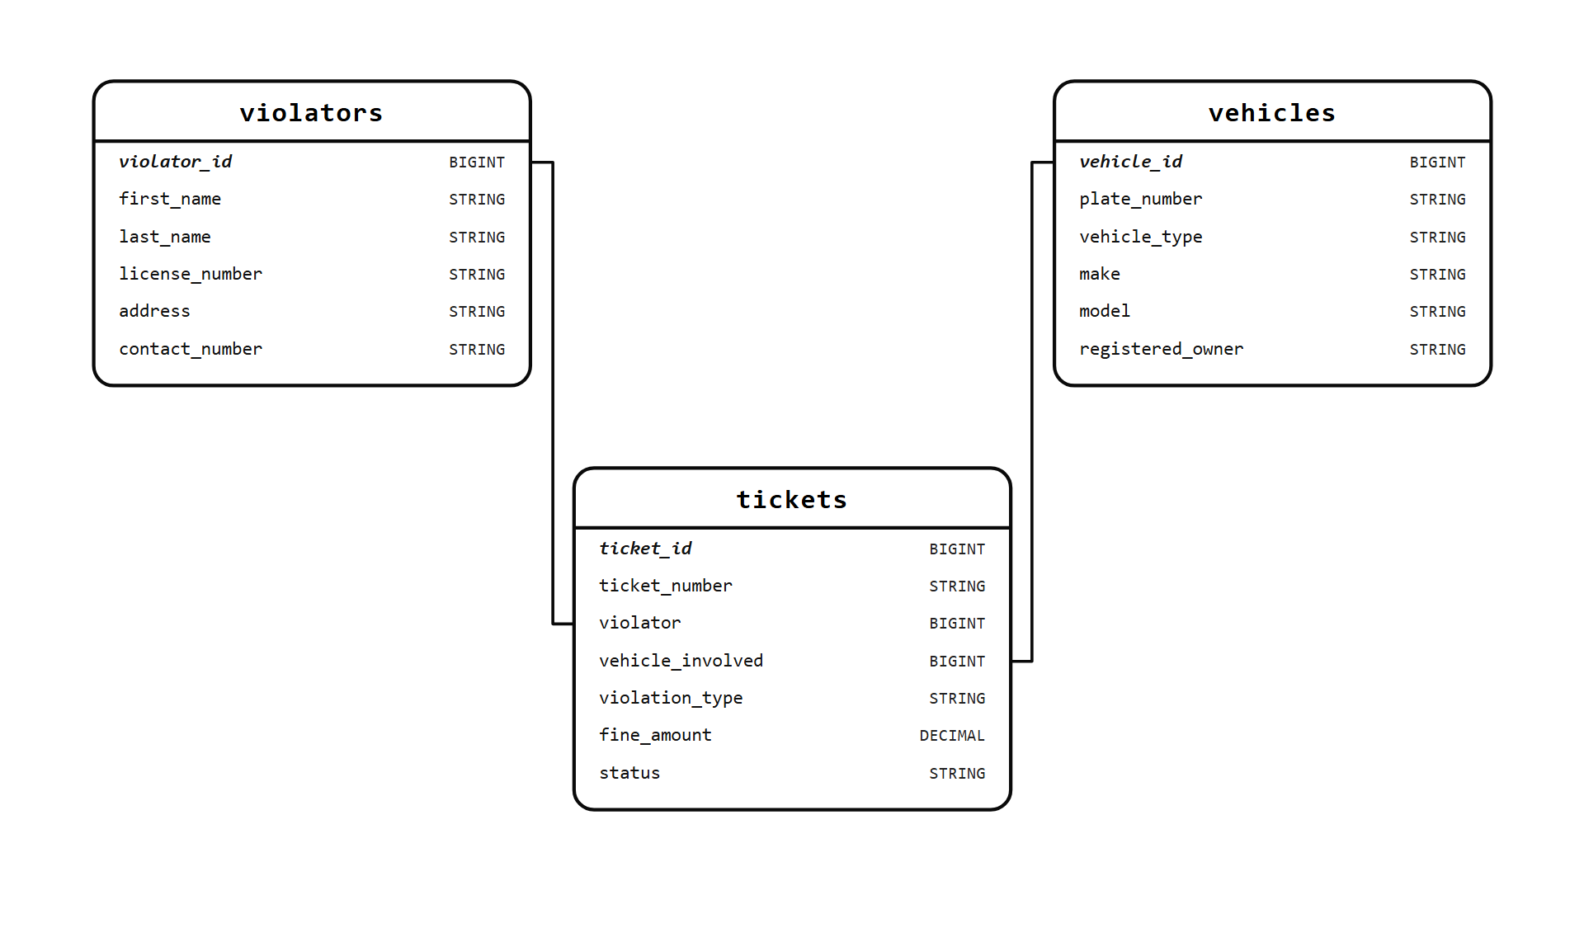
Data Architecture & ERD
CATEGORY A | CRITERION 3: SYSTEM DESIGN & ARCHITECTURE (15 PTS)
Antonio | 1.5 min
TIER 1 | PROTOTYPE: EMBEDDED SQLITE
Single-table design: edge-optimized violations entity
20 synchronized columns: ticket, driver, vehicle, itemized violations, overrides, evidence
Sub-millisecond local reads/writes, zero socket overhead
TIER 2 | TARGET CLOUD: NORMALIZED 3NF
OFFICERS
CHECKPOINTS
VIOLATORS
VEHICLES
OFFENSES
TICKETS
Core entities of the normalized 3NF model: violators, vehicles, tickets
TICKET_OFFENSES
PAYMENTS
Scales gracefully from a single checkpoint terminal to a nationwide police cloud.
AUDIT_LOGS
Offenses = JAO 2014-01 schedule; Payments = Treasury OR; audit logs immutable.
Notes:
SPEAKER: Antonio
ALLOTTED TIME: 1.5 Minutes
RUBRIC ALIGNMENT: Criterion 3 - Data Model & Schema (Target: 14-15/15 Excellent)
TALKING POINTS:
- A major technical highlight of PNP-CVPRMS is our dual-tier data persistence strategy.
- For our running demonstration prototype, we use an edge-optimized SQLite schema centering on the high-throughput violations entity with 20 synchronized attributes. This ensures sub-millisecond latency and offline durability on checkpoint laptops.
- Simultaneously, our documented target cloud architecture decouples data into a normalized Third Normal Form (3NF) schema comprising 8 relational entities: Officers, Checkpoints, Violators, Vehicles, Offenses, Tickets, Ticket_Offenses, and Treasury Payments.
- This proves to the panel that our data model scales gracefully from a single checkpoint terminal to a nationwide enterprise police cloud.

Slide 11
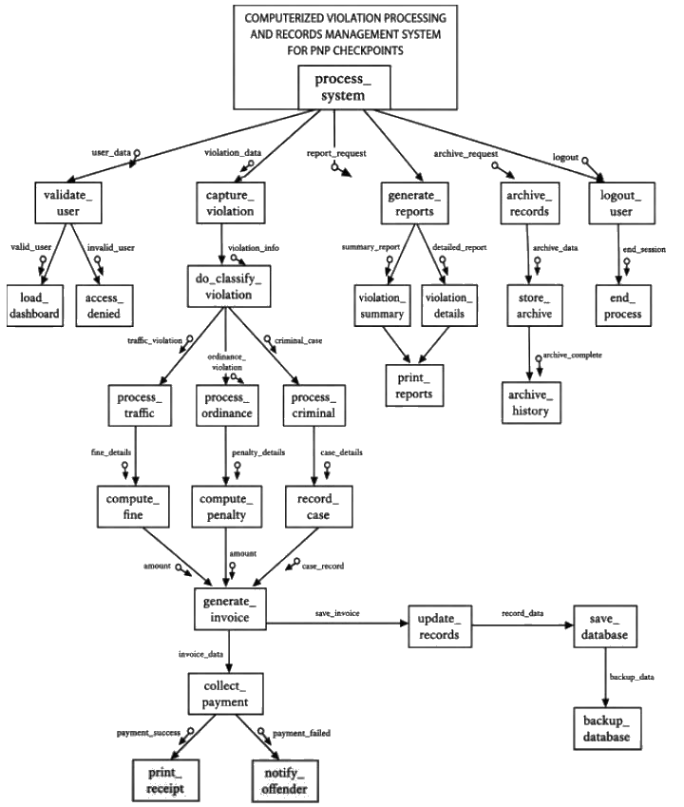
Modular Decomposition: Structure Chart
CATEGORY A | CRITERION 3: SYSTEM DESIGN & ARCHITECTURE (15 PTS)
Ranier | 1.5 min
TIER 1 | CLIENT CONTROLLERS
TIER 2 | BACKEND REST SERVICES
index.html
server.js
1.0 Session Controller
syncOfficerSession
2.0 Screening Controller
evaluateLocalScreening
3.0 Apprehension Form
violationForm SUBMIT
4.0 Registry Search
executeSearch, filterChips
5.0 Payment Adjudication
openRecordModal, saveStatus
6.0 Thermal Print
populateThermalReceipt
8.0 Express Dispatcher
endpoint routers
8.1 Defensive Validation
validateViolationPayload
8.2 Screening Engine
assessScreening
8.3 Fine Calculator
calculateViolationTotal
8.4 Ticket ID Generator
generateTicketNumber
8.5 SQLite Data Access
db.all, db.run, db.get
COUPLING CONTROL
High cohesion, loose coupling: structured JSON payloads (data couples) and strict HTTP status codes (control couples).
Notes:
SPEAKER: Ranier
ALLOTTED TIME: 1.5 Minutes
RUBRIC ALIGNMENT: Criterion 3 - Modular Diagrams & Hierarchy (Target: 14-15/15 Excellent)
TALKING POINTS:
- To guarantee maintainability and code clarity, PNP-CVPRMS was structured using top-down modular decomposition, documented via our HIPO VTOC and Structure Chart.
- In our Structure Chart, we decouple client-side event controllers from our backend RESTful service layer and SQLite persistence engine.
- Notice the explicit distinction between Data Couples - such as sanitized citation JSON payloads - and Control Couples - such as boolean validation flags and HTTP 400/404 return codes.
- This architectural separation ensures that backend calculation routines and validation logic remain completely testable in isolation.

Slide 12




Technology Stack & Trade-offs
CATEGORY A | CRITERIA 3 & 4: DESIGN DECISIONS
Benjie & Antonio | 3.0 min
BACKEND PLATFORM
PERSISTENCE ENGINE
FRONTEND INTERFACE
PLATFORM AUTOMATION
Node.js + Express 4.19
SQLite3 embedded
HTML5, CSS3, vanilla ES6+
PowerShell & Windows batch
Non-blocking async I/O for concurrent REST calls
/api/violations, /api/screen, /api/reports
10 MB body limit; parameterized queries stop SQL injection
File-based ACID database (pnp_checkpoint.db)
Zero config, zero external services, USB-portable
Indexed ticket, plate, driver, time: sub-50 ms search
CSS Grid & Flexbox, high contrast for daylight
Custom @media print for 58/80 mm thermal rolls
Native canvas compression for evidence photos
Start-CVPRMS.bat: one-click launch with preflight
Create-CVPRMS-Shortcut.bat: PNP-badged shortcut
node --test: built-in runner, 14 regression tests
TRADE-OFFS WE ACCEPTED
SQLite vs. cloud DB
Zero-latency, 100% offline uptime at remote posts. Cost: no multi-writer concurrency; PostgreSQL is on the roadmap.
Vanilla ES6+ vs. SPA frameworks
No build step, under 100 KB, instant load. Cost: manual DOM updates, fine for a single-screen workflow.
Local blacklist vs. live APIs
Reliable demo with no VPN or IP whitelisting. Cost: curated prototype data instead of live LTO / HPG feeds.
Notes:
SPEAKER: Antonio
ALLOTTED TIME: 1.5 Minutes
RUBRIC ALIGNMENT: Criterion 3 - Trade-offs and Engineering Rationale (Target: 14-15/15 Excellent)
TALKING POINTS:
- Strong software engineering is defined not by chasing the newest buzzwords, but by making defensible trade-offs suited to the operational environment.
- We made four deliberate design decisions:
1. We selected SQLite over cloud databases for the prototype because zero-downtime offline reliability at remote checkpoints is paramount.
2. We selected Vanilla JavaScript and semantic CSS over React or Angular to eliminate bundler dependencies and ensure instant startup.
3. We compressed photos in the client browser canvas before transmission, preventing HTTP 413 payload errors.
4. We created a deterministic local rule engine to ensure 100% dependable test execution during panel defense without depending on live police VPNs.
--- Content merged from the former slide 13 ---
SPEAKER: Benjie
ALLOTTED TIME: 1.5 Minutes
RUBRIC ALIGNMENT: Criterion 4 - Tech Stack & Implementation Decisions (Target: 9-10/10 Excellent)
TALKING POINTS:
- Our technology stack balances modern web standards with bulletproof operational simplicity.
- On the backend, Node.js and Express deliver lightweight, asynchronous REST routing with a 10MB body parser limit to support base64 digital evidence.
- Our persistence layer uses SQLite3 with parameterized queries, preventing SQL injection while guaranteeing portable, zero-configuration USB transfer for presentations.
- On the frontend, semantic HTML5, responsive CSS Grid, and custom @media print thermal styling give officers an ergonomic, sunlight-readable UI.
- Finally, our platform includes automated Windows batch and PowerShell launchers that verify dependencies and install desktop shortcuts on any host computer.

Slide 13
Core Algorithms & Business Logic
CATEGORY A | CRITERION 4: IMPLEMENTATION (10 PTS)
Benjie | 1.5 min
ALGORITHM 1 | SCREENING ENGINE
ALGORITHM 2 | UNLICENSED WORKFLOW
ALGORITHM 3 | STATUTORY TOTALING
assessScreening(license, plate, driver)
validateViolationPayload(data)
calculateViolationTotal(violations)
1
Plate on HPG stolen list
Auto-lock: "No Driver's License" sets the license field to N/A - Unlicensed
No false alarms: screening skips N/A licenses
Alt-ID required: PhilID / National ID, Passport, SSS/GSIS, Voter's ID, PRC, or Senior/PWD ID
Rejects submissions missing the Alt-ID type or document number
OFFENSE_SCHEDULE | FINE (PHP)
No Driver's License | ₱1,500
Expired Registration | ₱1,200
No Helmet / Seatbelt | ₱1,000
DUI | ₱5,000
Distracted Driving | ₱5,000
Reckless / Counterflow | ₱3,000
Smoke Belching | ₱1,500
ALARM
2
Driver on court-warrant list
ALARM
3
Suspended / repeat-offender license
WARNING
4
Expiration check (EXPIRED)
WARNING
Verified by tests: fails without an Alt-ID and passes with a valid National ID.
Discretionary override: authorizes manual fines while logging the original statutory total for audit.
5
Clean motorist
CLEAR
Notes:
SPEAKER: Benjie
ALLOTTED TIME: 1.5 Minutes
RUBRIC ALIGNMENT: Criterion 4 - Business Logic & Design Patterns (Target: 9-10/10 Excellent)
TALKING POINTS:
- On this slide, we examine our three core backend algorithms implemented in server.js.
- Algorithm 1 is our Multi-Tier Screening Engine: It analyzes plates, drivers, and licenses to instantly return Clear, Warning, or Alarm badges.
- Algorithm 2 is our Defensive Validation Module: It enforces our specialized Unlicensed Driver Workflow. If a driver has no license, the system locks the license field, suppresses false alerts, and mandates an alternative government ID like PhilID or SSS.
- Algorithm 3 is our Statutory Fine Calculator: It queries our centralized offense schedule to compute compound fines under Philippine law, while supporting authorized supervisory fine overrides with an immutable audit log.

Slide 14
Technical Challenges & Solutions
CATEGORY A | CRITERION 4: IMPLEMENTATION (10 PTS)
Emmanuel John | 1.5 min
CHALLENGE
PROBLEM
SOLUTION
HTTP 413 'payload too large'
Phone photos of licenses (5-10 MB) exceeded Express body limits and crashed uploads.
Client-side canvas downsampling (max 1200 px, 0.7 JPEG) cuts payloads ~95% to under 150 KB; express.json limit set to 10 MB.
1
Excel CSV encoding corruption
Peso signs and Filipino accents appeared as garbled characters when Treasury opened the CSV export in Excel.
Prepended the UTF-8 byte order mark (\uFEFF) to the CSV blob so Windows Excel reads full UTF-8.
2
Thermal POS vs. A4 print centering
58/80 mm printers overflowed to multiple pages; A4 setups printed blank trailing rolls.
Custom @media print CSS with fixed mm containers (max-width 76 mm): centered on A4, exact fit on thermal rolls.
3
Impound receipt enforcement
'Impounded' vehicles were sometimes submitted without slip numbers: a chain-of-custody gap.
Conditional validation in client JavaScript and the backend API rejects any impound without a valid slip number.
4
Notes:
SPEAKER: Emmanuel John
ALLOTTED TIME: 1.5 Minutes
RUBRIC ALIGNMENT: Criterion 4 - Challenges and Solutions in Depth (Target: 9-10/10 Excellent)
TALKING POINTS:
- Real-world development is defined by overcoming concrete technical hurdles. Here are four key engineering challenges we resolved:
1. High-resolution mobile photos were crashing our server with HTTP 413 Payload Too Large errors. We engineered a client-side canvas compression pipeline that reduces photos to under 150KB before upload.
2. Microsoft Excel was corrupting our Philippine Peso sign into strange characters. We solved this by injecting a UTF-8 Byte Order Mark directly into the CSV export stream.
3. Continuous thermal printing on 58mm and 80mm roll printers required specialized @media print CSS rules to eliminate paper waste and clipping.
4. Chain of custody on impounded vehicles was secured by adding conditional validation requiring mandatory impound slip serial numbers.

Slide 15
Testing Strategy & QA Evidence
CATEGORY A | CRITERION 5: TESTING & QA (10 PTS)
Genuflect | 3.0 min
TIER 1
Unit testing
Algorithmic correctness of isolated routines
AUTOMATED TEST SCOREBOARD
Multi-offense fine totals and the expanded 14-violation schedule (RA 4136, JAO 2014-01)
Ticket numbers match /^PNP-\d{8}-[A-Z0-9]{6}$/
Pure screening logic: Alarm, Warning, Clear
14 / 14
TESTS PASSING | 100% PASS RATE
TIER 2
Defensive validation
Boundary conditions and trust-boundary defense
Execution time: 5.69 seconds
Alt-ID required for unlicensed drivers; valid license required when licensed
Fine override authorization is verified
Impound slip mandatory when disposition is 'Impounded'
Framework: native node:test
Assertions: node:assert/strict
Result: 14 pass, 0 fail, 0 skipped
Zero flaky tests: isolated local SQLite
TIER 3
Integration & API
End-to-end REST endpoints and SQLite transactions
PATCH status transitions; invalid statuses rejected
GET /search (ticket, officer, plate, driver) and /reports/summary KPIs
POST ingests base64 evidence over 100 KB without payload errors
RE-RUN ANYTIME
cd 'Source Code' && node --test
Notes:
SPEAKER: Genuflect
ALLOTTED TIME: 1.5 Minutes
RUBRIC ALIGNMENT: Criterion 5 - Test Strategy and QA (Target: 9-10/10 Excellent)
TALKING POINTS:
- Under Criterion 5, our testing methodology spans three distinct tiers: Unit Tests, Defensive Input Validation, and Integration API testing.
- We used Node.js's built-in test runner (
ode:test and
ode:assert/strict), which eliminates heavy third-party testing dependencies while giving us complete assertions over our asynchronous Express routes and SQLite database.
- Every layer of the application is tested: from statutory penalty math and ticket number regex patterns to conditional validation for unlicensed motorists and live PATCH updates for Treasury settlements.
--- Content merged from the former slide 17 ---
SPEAKER: Genuflect
ALLOTTED TIME: 1.5 Minutes
RUBRIC ALIGNMENT: Criterion 5 - QA Evidence and Results (Target: 9-10/10 Excellent)
TALKING POINTS:
- To provide indisputable evidence of code quality for Criterion 5, here are the actual results from our automated test suite.
- As seen on screen, all 14 test cases pass with a 100% success rate in under 6 seconds.
- Every edge case is explicitly validated:
- We test that multiple statutory violations add up to exactly ₱14,200.
- We test that unlicensed drivers trigger alternative ID requirements without false license alarms.
- We test that impounded vehicles require valid impound slips.
- And we verify that large base64 digital photos upload seamlessly without HTTP 413 errors.
- Any member of the panel can run
ode --test right now to verify these 14 assertions independently.

Slide 16
Project Management & SCM Governance
CATEGORY A | CRITERION 6: PROJECT MANAGEMENT & SCM (5 PTS)
Ranier | 1.5 min
1
SPRINT 1
2
SPRINT 2
3
SPRINT 3
4
SPRINT 4
Problem discovery & SCM baseline
Core backend & schema
Ergonomic UI & thermal POS
Defensive hardening & SCM audit
Stakeholder interviews at Agoo MPS
SCM_PLAN.md defined
Baseline v1.0.0 approved
Express REST + SQLite init
Statutory fine engine
Rule-based screening with watchlists
Responsive high-contrast UI
Canvas compression (<150 KB)
ESC/POS 58/80 mm receipts
14-test regression suite
UTF-8 BOM CSV export
Config audit & v2.0-PRO tag
FORMAL SCM GOVERNANCE (SCM_PLAN.md)
20
controlled configuration items in 5 classes
v1.0.0 to v2.0-PRO
strict semantic versioning
0
direct pushes: tests gate every merge
1 Change request
2 Reason for change
3 Develop & test
4 Pull request review
5 Approve & merge
Notes:
SPEAKER: Ranier
ALLOTTED TIME: 1.5 Minutes
RUBRIC ALIGNMENT: Criterion 6 - Project Management & Process (Target: 5/5 Excellent)
TALKING POINTS:
- Under Criterion 6, our project was managed using an Agile Scrum process across four distinct sprints, backed by a formal Software Configuration Management (SCM) plan.
- Our SCM_PLAN.md governs 20 configuration items across five classes: source code, schema, dependencies, automated tests, and documentation.
- We maintained strict Semantic Versioning starting from baseline v1.0.0 to our current v2.0-PRO release.
- Every modification followed a 5-step change request workflow: request, rationale, test validation with
ode --test, peer review, and authorized merge.
- This configuration discipline prevented regression defects and merge conflicts across all 8 team members.

Slide 17
Live Demo: 8-Step Checkpoint Walkthrough
CATEGORY B | LIVE SYSTEM DEMONSTRATION (15 PTS)
Casey Freud & Team | 6-8 min
1
Session initialization
2
Live screening engine
3
Violations & unlicensed flow
4
Disposition & impound
Station: Agoo MPS
Post: San Nicolas Norte
Shift 2 (14:00-22:00)
Clock sync & badge binding
Valid driver: green CLEAR
Expired reg.: amber WARNING
Plate ABC-1234: red ALARM
'No Driver's License' locks field
PhilID Alt-ID required
Multiple offenses total ₱3,700
Set vehicle to 'Impounded'
Submission blocked until slip number is entered
5
Evidence & thermal receipt
6
Registry & multi-field search
7
Dossier & treasury settlement
8
CSV export & live KPIs
Photo: instant compression
Issue citation: unique ticket ID
58/80 mm receipt preview
Ticket, plate, driver queries
Chips: Today, Active Shift, Flagged Alarms, Unsettled
Open dossier with photo
Mark Settled / Paid
Record OR number; state updates
Excel CSV shows ₱ correctly
Header KPIs update in real time
Notes:
SPEAKER: Casey Freud & Team
ALLOTTED TIME: 6.0 to 8.0 Minutes
RUBRIC ALIGNMENT: Category B - Live Demonstration (Target: 14-15/15 Excellent)
DEMONSTRATION SCRIPT & OPERATOR ACTIONS:
- Now, our team transitions to Category B: the Live System Demonstration of our working v2.0-PRO software.
- [Switch to browser running at http://localhost:3000]
- Step 1: Point out the Checkpoint Session banner: Station Agoo MPS, Post San Nicolas Norte, Shift 2 Afternoon, and live synchronized clock.
- Step 2: In the screening input, enter plate 'ABC-1234'. Show the panel the high-visibility RED ALARM badge identifying an HPG Stolen Vehicle match.
- Step 3: Fill out the apprehension form. Choose 'No Driver's License'. Show how the license box is disabled, and the system prompts for a Philippine National ID. Pick 'Expired Registration' and 'No Helmet' to demonstrate instant statutory totaling.
- Step 4: Toggle disposition to 'Impounded' and show the mandatory towing receipt validation.
- Step 5: Attach an evidence photo, click Submit, and trigger the Thermal POS Print Preview to display the 58mm/80mm ticket.
- Step 6: Scroll down to the Centralized Registry. Search for the new ticket. Toggle the 'Unsettled Only' and 'Flagged Alarms' filter chips.
- Step 7: Open the dossier modal. Simulate the Municipal Treasury payment by changing status to 'Settled'.
- Step 8: Click Export CSV and point out how the KPI dashboard counters updated in real time.

Slide 18
Operational Analytics & KPI Dashboard
TECHNICAL CONTENT & LIVE DEMO | KPI ANALYTICS
Casey Freud | 1.5 min
284
₱440,000
62
189
Total apprehensions
Citations issued across shifts
Total fines levied
Cumulative JAO-schedule penalties
Flagged alerts (22%)
HPG stolen vehicles & warrant matches
Unsettled (66%)
Balances still due at Treasury
Infraction distribution: top offenses (cases, JAO 2014-01)
Fines by shift (₱ thousands)
Citations by checkpoint post
Tactical insight: unlicensed driving and helmet violations (51% of cases) justify prioritized motorcycle checkpoint interdiction.
Notes:
SPEAKER: Casey Freud
ALLOTTED TIME: 1.5 Minutes
RUBRIC ALIGNMENT: Criterion 3 & Category B - Analytics & Operational Insights
TALKING POINTS:
- In addition to operational citation processing, PNP-CVPRMS provides high-level executive analytics for station commanders.
- As shown on screen, the system dynamically calculates four critical metrics via GET /api/reports/summary.
- Looking at our infraction breakdown, 'No Driver's License' and 'No Helmet' account for over 50% of all apprehensions, confirming the need for sustained motorcycle interdiction along provincial boundaries.
- Furthermore, shift analysis reveals that Shift 2 (Afternoon) generates peak citation revenue (₱210,000), while San Nicolas Norte represents the densest enforcement bottleneck in Agoo.

Slide 19
Summary, Lessons & Roadmap
DELIVERY, ROADMAP & Q&A | RUBRIC CATEGORY C
Casey Freud & Ranier | 3.0 min
WHAT WE DELIVERED
LESSONS LEARNED
CLOUD ROADMAP
Working v2.0-PRO prototype: Node.js/Express + SQLite3 edge app for Agoo MPS
Full traceability: requirements to code, schema and 14 passing tests
Field-ready: sub-minute citations, photo compression, thermal print
Complete documentation: DFDs, 3NF ERD, HIPO, data dictionary, SCM plan
SCM early: ownership and test gates prevented merge conflicts across 8 members
Validate on the server: client checks are easily bypassed
Design for real hardware: phone photos and narrow thermal rolls
Edge-first reliability: zero-latency local operation eases cloud migration
Cloud migration: PostgreSQL on AWS / Google Cloud with read replicas
WebSockets / SSE: broadcast stolen-vehicle and warrant flags
Gateways: LTO LTMS and PNP Directorate for Intelligence
Online payments: Landbank Link.BizPortal, GCash, Maya
Mobile patrol PWA: offline-first for rugged handhelds
Thank you. We are ready for the panel Q&A.
Every team member is prepared to answer questions.
Notes:
SPEAKER: Casey Freud & All Members
ALLOTTED TIME: 1.5 Minutes presentation wrap-up + 10.0 Minutes Panel Q&A
RUBRIC ALIGNMENT: Category C - Speaking, Organization and Q&A Defense (25/25 pts)
TALKING POINTS:
- In summary, our team has delivered a fully tested, field-resilient violation processing system that addresses real-world law enforcement bottlenecks for the Philippine National Police.
- We have validated every requirement against our automated test suite and documented the complete software engineering lifecycle from DFDs and ERDs to formal SCM governance.
- Looking ahead, our architecture provides a seamless roadmap toward a nationwide cloud deployment with live LTO LTMS integration and online treasury payments.
- We sincerely thank our panel of evaluators for their time and guidance. Our team is now prepared and eager to take your questions. Every member will answer at least one question.
--- Content merged from the former slide 19 ---
SPEAKER: Ranier
ALLOTTED TIME: 1.5 Minutes
RUBRIC ALIGNMENT: Criterion 6 - Task Allocation and Lessons Learned (Target: 5/5 Excellent)
TALKING POINTS:
- On this slide, we present our complete Task Allocation Matrix and Engineering Lessons Learned.
- As documented in our SCM Plan, every team member took clear ownership of specific functional modules, documentation artifacts, and configuration items.
- Key lessons learned:
1. Strict configuration baselines and automated tests allowed our 8-person team to work concurrently without overwriting code.
2. Always enforce defensive validation on the server - client forms alone are never sufficient.
3. Designing for real-world constraints - such as mobile image compression and thermal POS printing - is what separates a toy demo from a production-grade law enforcement tool.

